Slide 1
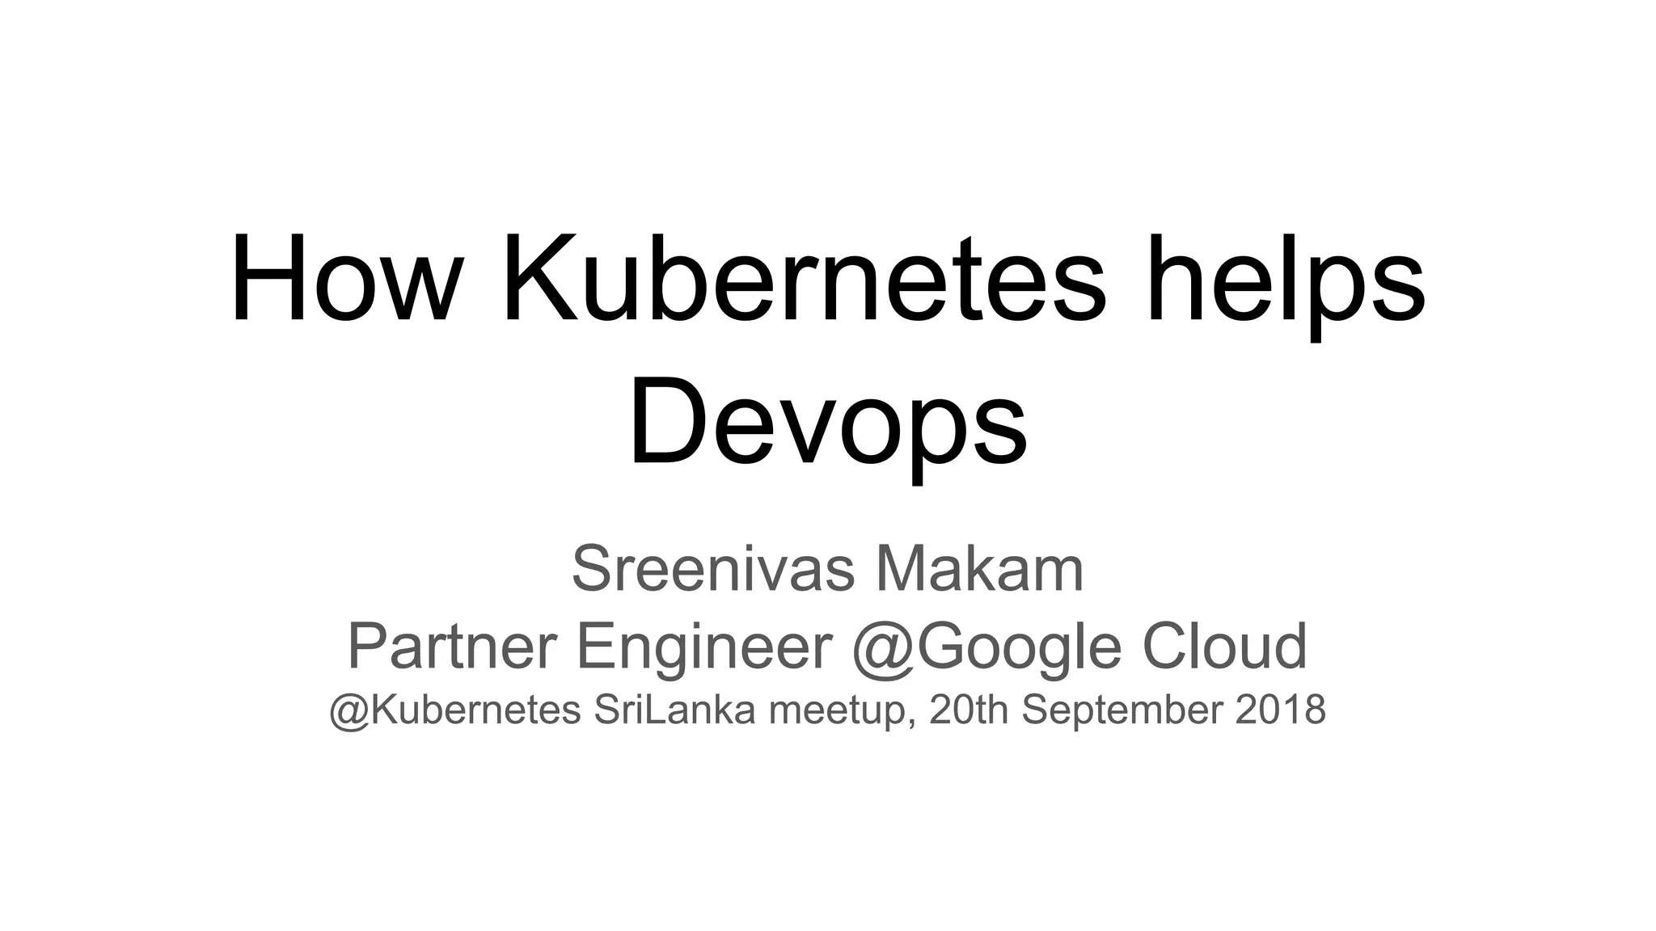



Slides By Atharva Shah,
SYMCA, 2023510051 Technical Specialist @AccuKnox
https://www.linkedin.com/in/atharva-shah-tech/
https://github.com/HighnessAtharva/
https://atharvashah.netlify.app/

Slide 2
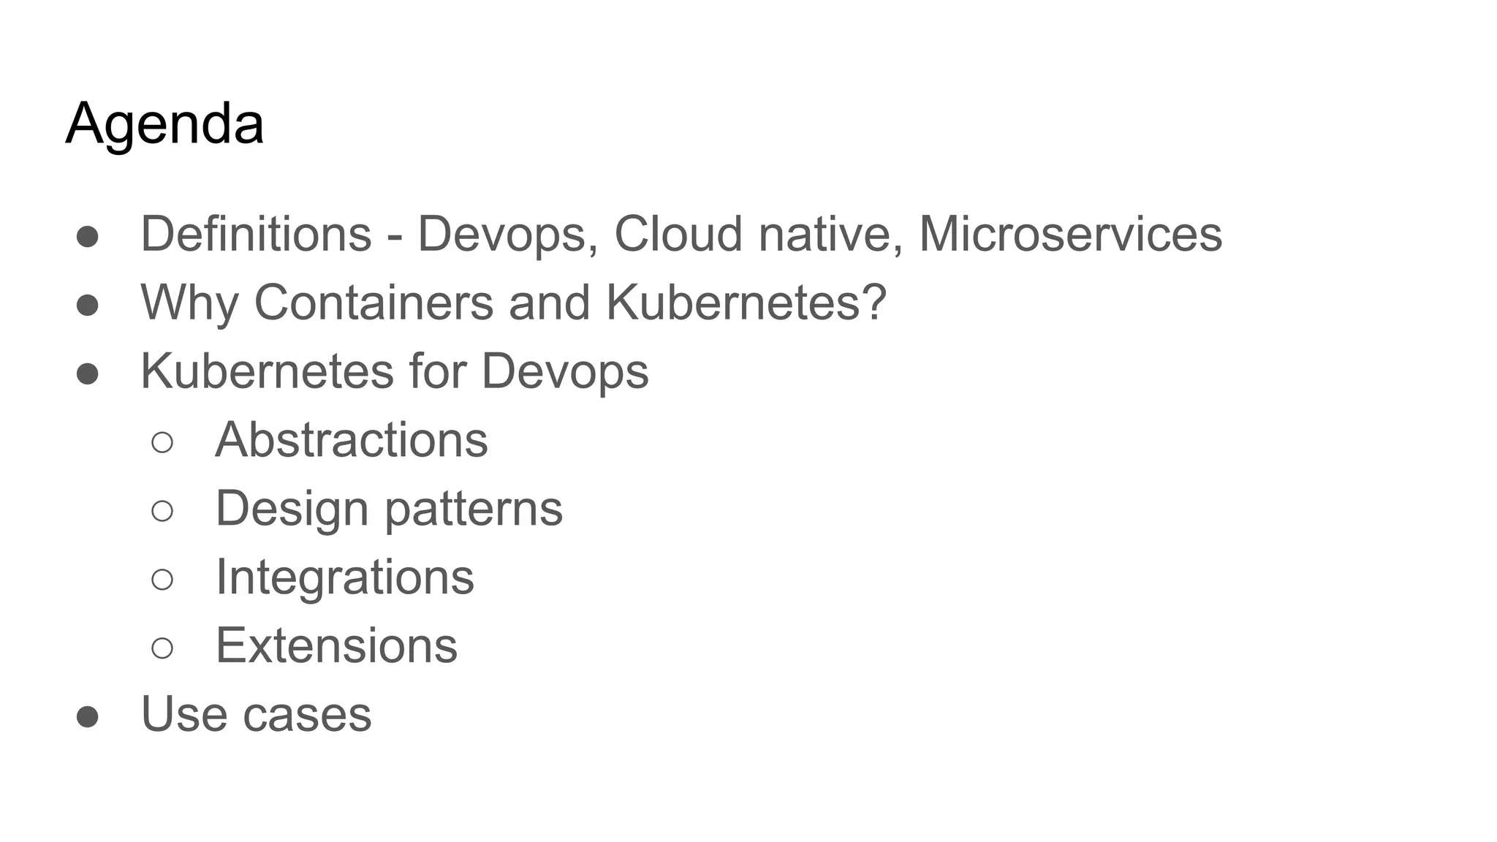

Slide 3
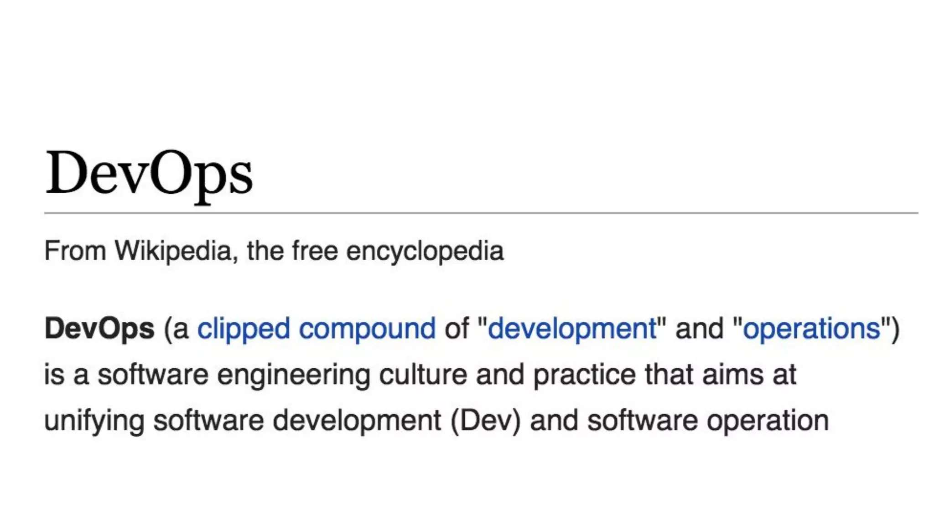

Slide 4
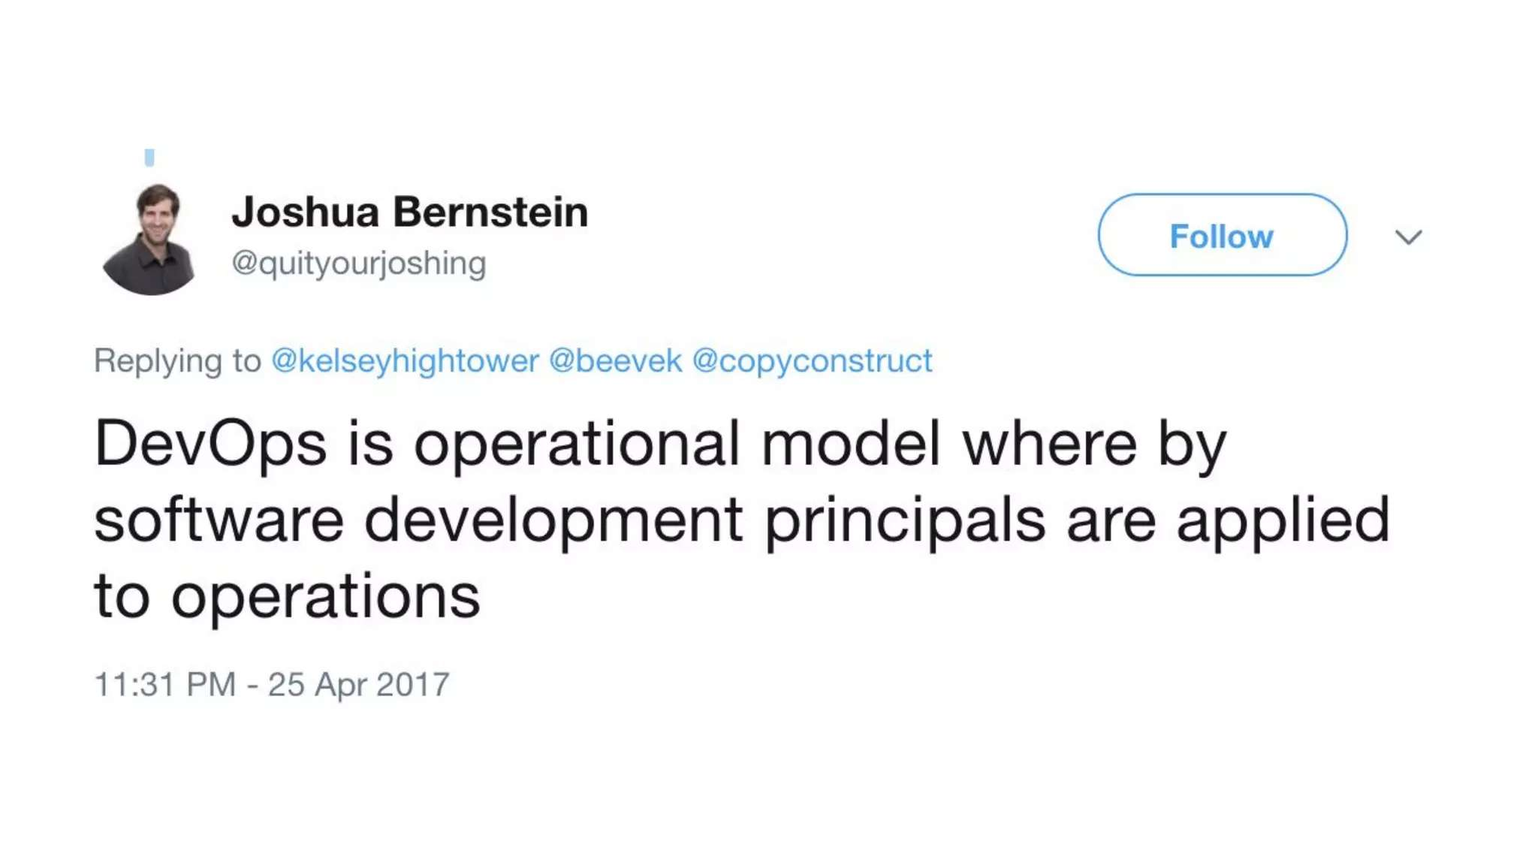

Slide 5
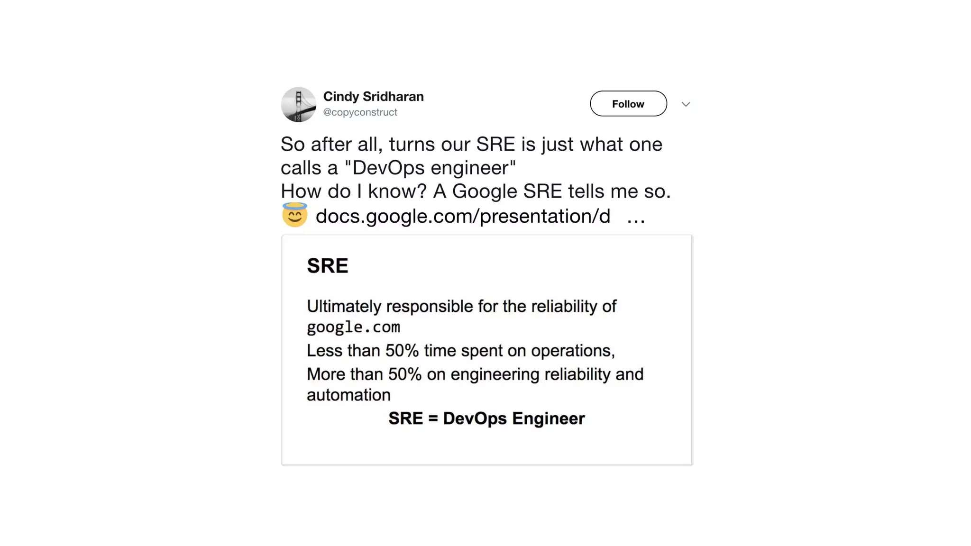

Slide 6
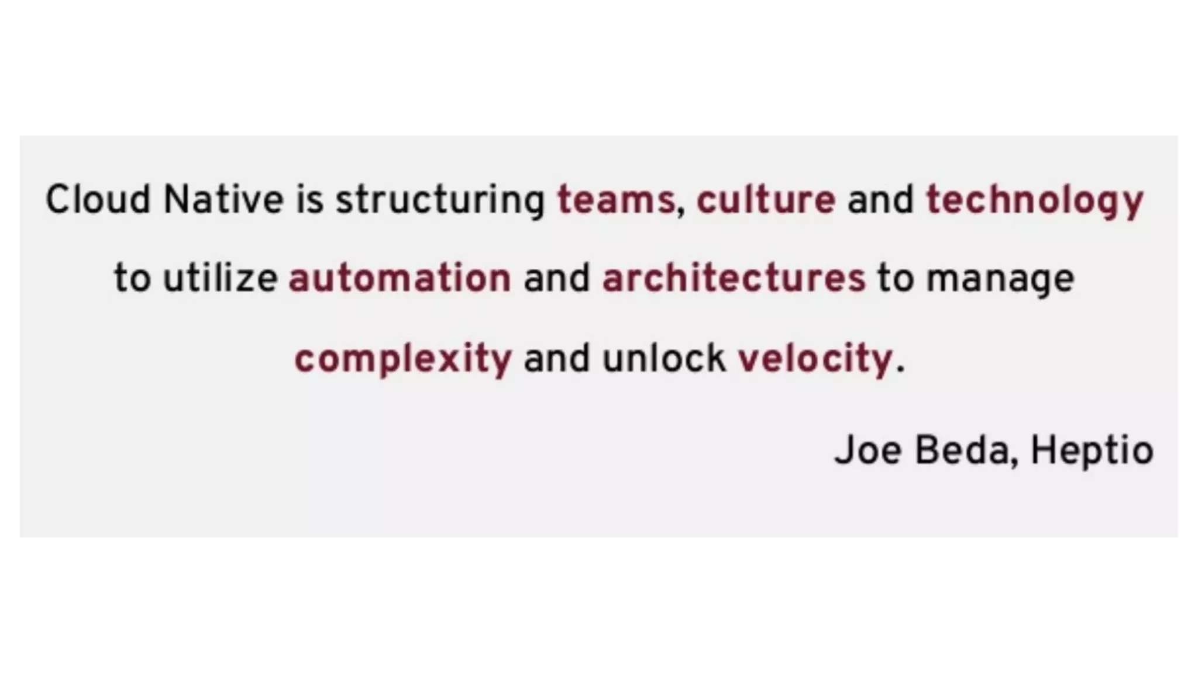

Slide 7
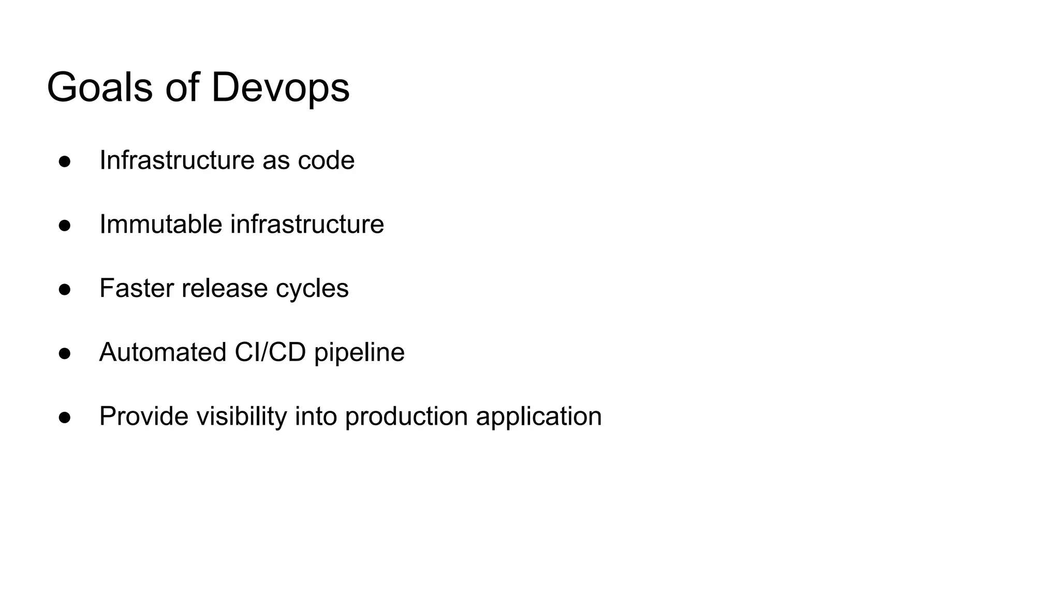

Slide 8
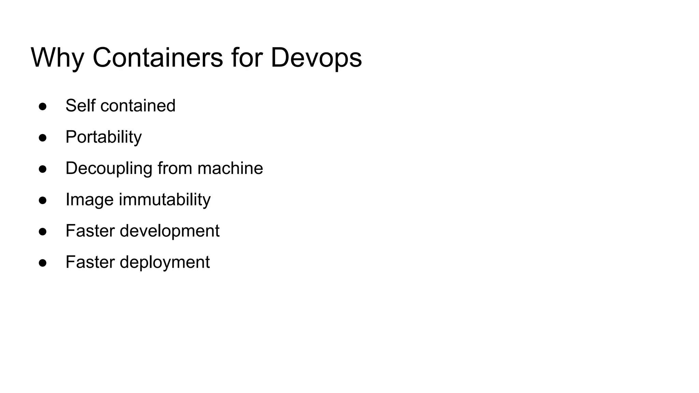

Slide 9
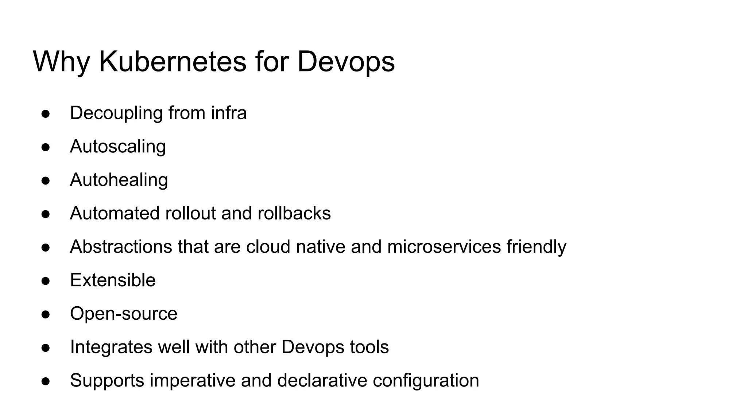

Slide 10
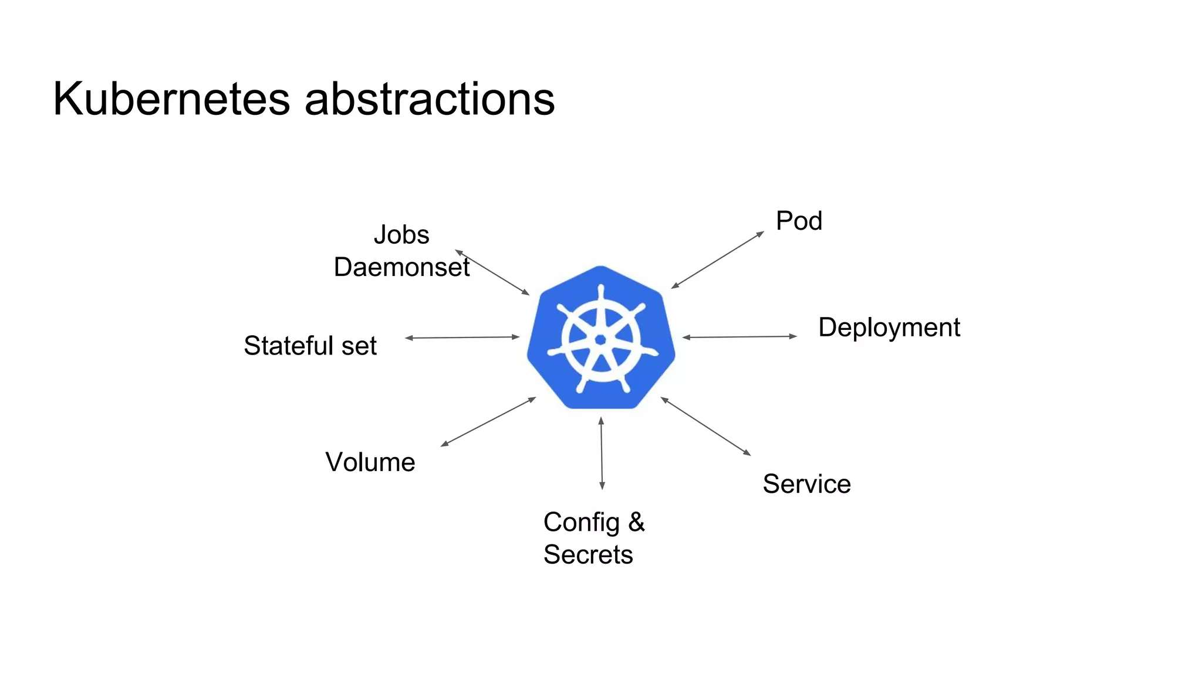

Slide 11
Intro - What is Kubernetes?
Kubernetes or K8s was a project spun out of Google as a open source next-gen container scheduler designed with the lessons learned from developing and managing Borg and Omega.
Kubernetes was designed from the ground-up as a loosely coupled collection of components centered around deploying, maintaining, and scaling applications.

Slide 12
Intro - What Does Kubernetes do?
Kubernetes is the linux kernel of distributed systems.
It abstracts away the underlying hardware of the nodes and provides a uniform interface for applications to be both deployed and consume the shared pool of resources.

Slide 13
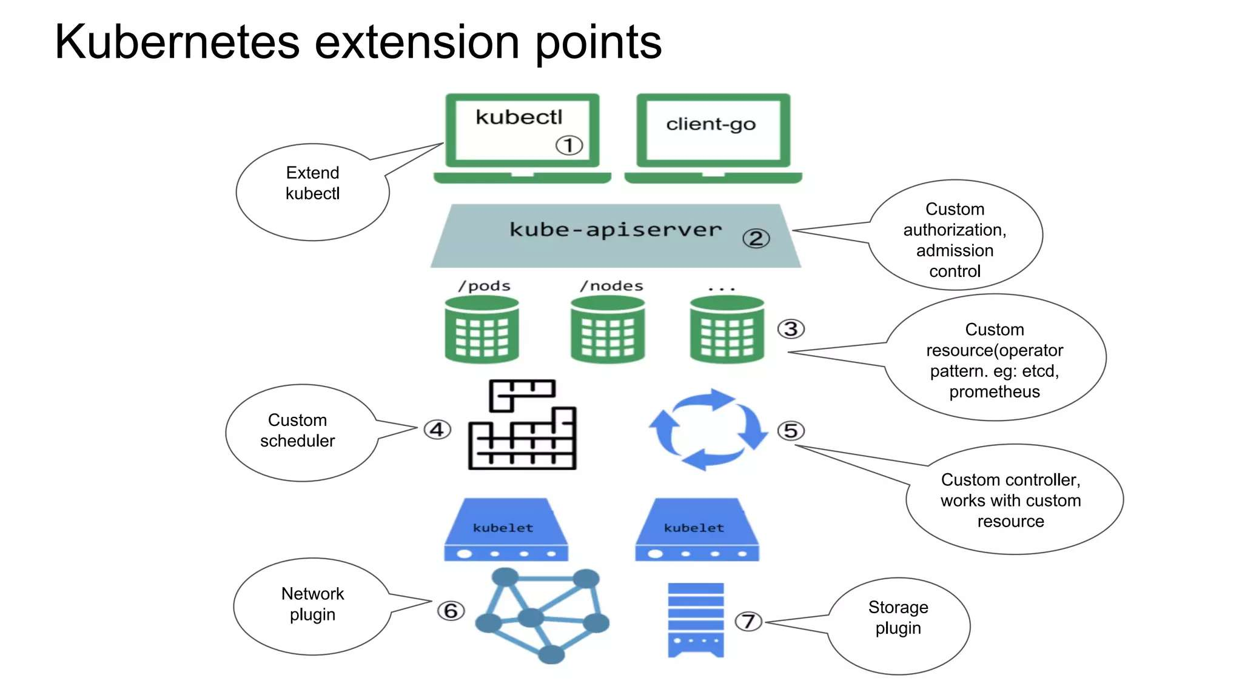

Slide 14
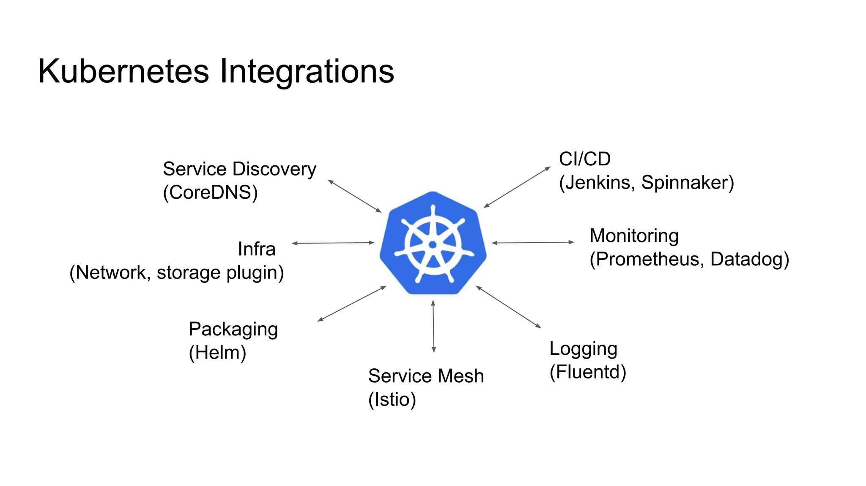

Slide 15
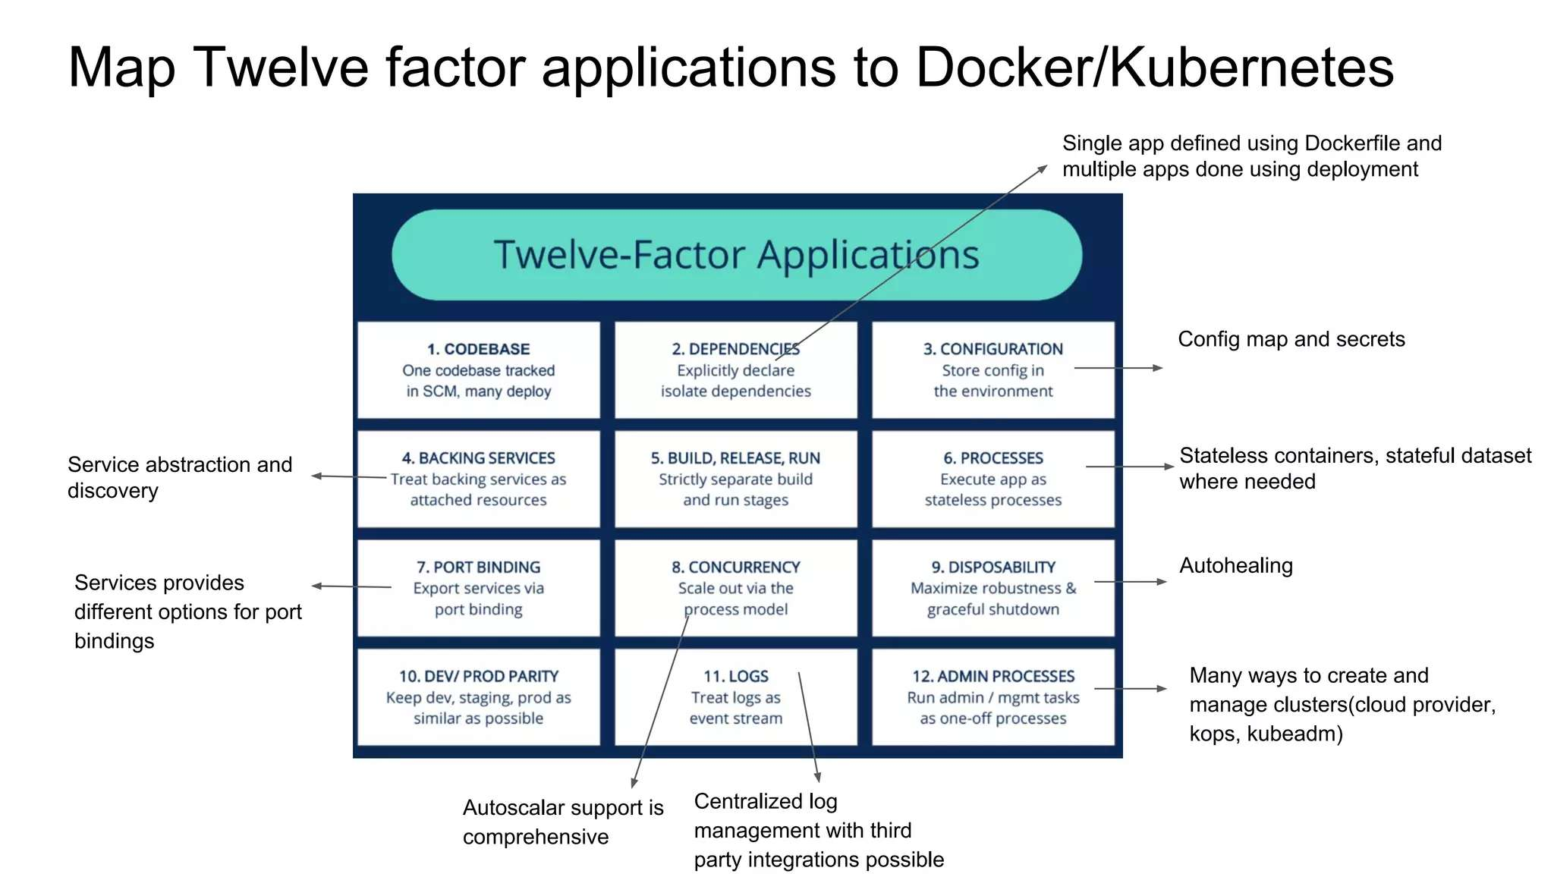

Slide 16
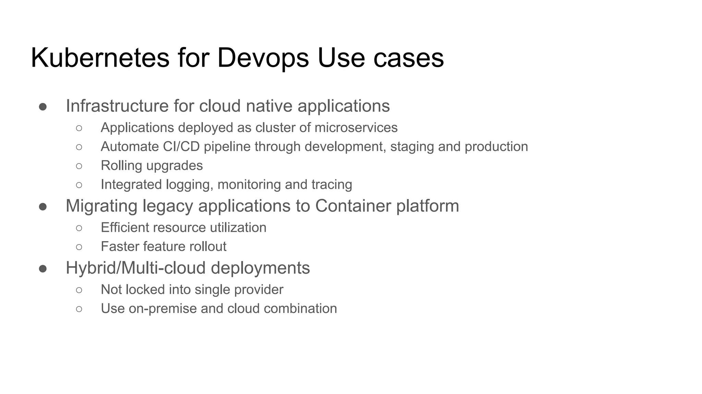

Slide 17
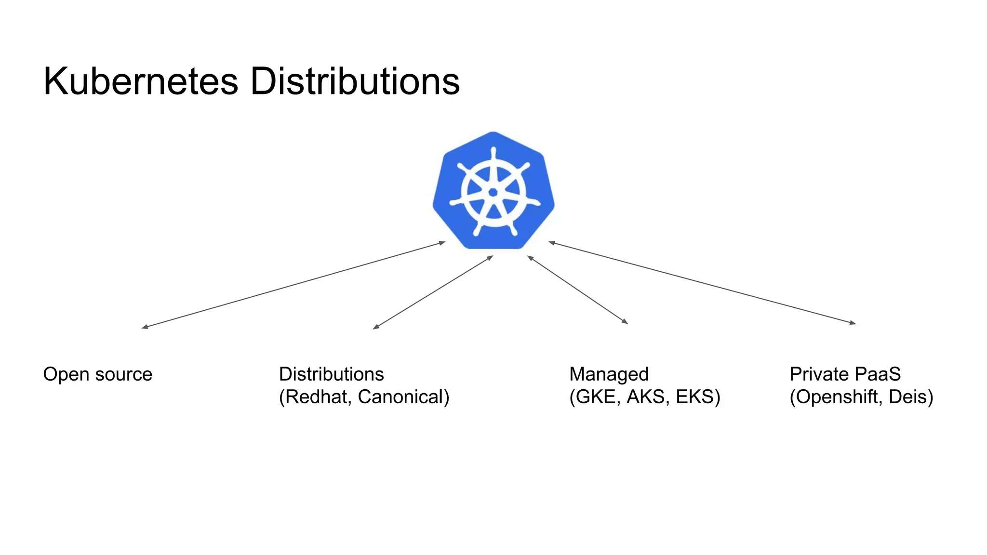

Slide 18
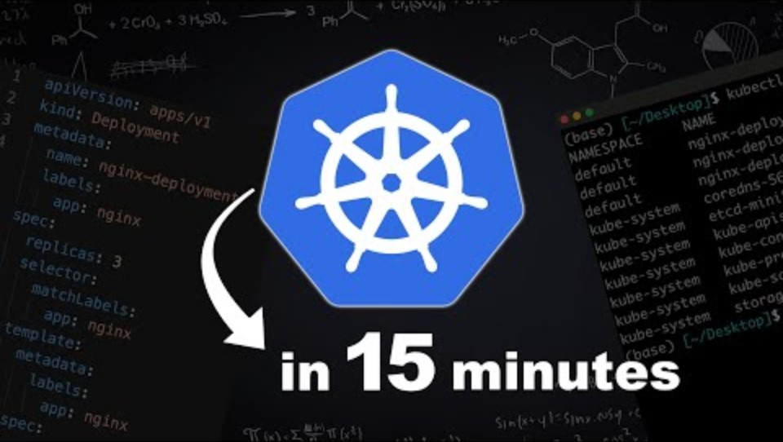
DEMO SCENARIO

Slide 19

Kubernetes
Concepts

Slide 20
Kubernetes Concepts - Core
Cluster - A collection of hosts that aggregate their available resources including cpu, ram, disk, and their devices into a usable pool.
Master - The master(s) represent a collection of components that make up the control plane of Kubernetes. These components are responsible for all cluster decisions including both scheduling and responding to cluster events.
Node - A single host, physical or virtual capable of running pods. A node is managed by the master(s), and at a minimum runs both kubelet and kube-proxy to be considered part of the cluster.
Namespace - A logical cluster or environment. Primary method of dividing a cluster or scoping access.

Slide 21
Concepts - Core (cont.)
Label - Key-value pairs that are used to identify, describe and group together related sets of objects. Labels have a strict syntax and available character set. *
Annotation - Key-value pairs that contain non-identifying information or metadata. Annotations do not have the the syntax limitations as labels and can contain structured or unstructured data.
Selector - Selectors use labels to filter or select objects. Both equality-based (=, ==, !=) or simple key-value matching selectors are supported.
* https://kubernetes.io/docs/concepts/overview/working-with-objects/labels/#syntax-and-character-set

Slide 22
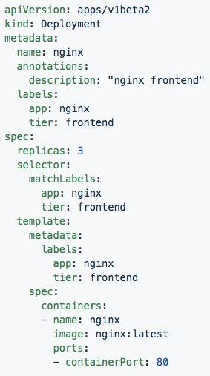
Labels, and Annotations, and Selectors
Labels:
app: nginx tier: frontned
Annotations
description: “nginx frontend”
Selector: app: nginx
tier: frontend

Slide 23
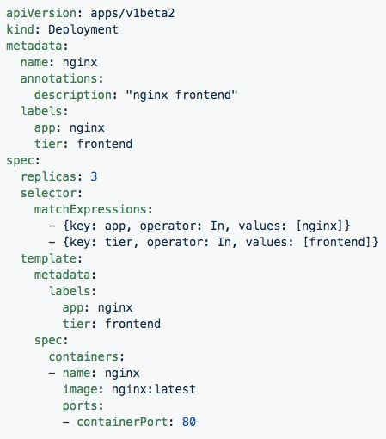
Set-based selectors
Valid Operators:
In
NotIn
Exists
DoesNotExist
Supported Objects with set-based selectors:
Job
Deployment
ReplicaSet
DaemonSet
PersistentVolumeClaims

Slide 24
Concepts - Workloads
Pod - A pod is the smallest unit of work or management resource within Kubernetes. It is comprised of one or more containers that share their storage, network, and context (namespace, cgroups etc).
ReplicationController - Method of managing pod replicas and their lifecycle. Their scheduling, scaling, and deletion.
ReplicaSet - Next Generation ReplicationController. Supports set-based selectors.
Deployment - A declarative method of managing stateless Pods and ReplicaSets. Provides rollback functionality in addition to more granular update control mechanisms.

Slide 25
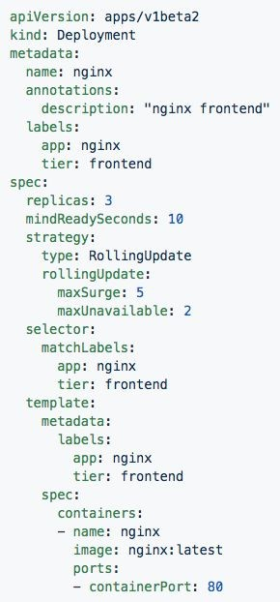
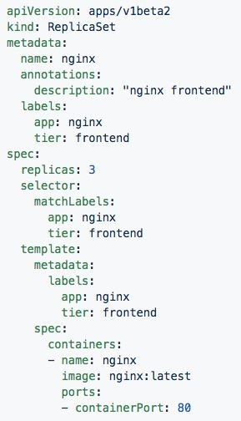
Deployment
ReplicaSet
Generated ReplicaSet from Deployment spec.
Contains configuration of how updates or ‘deployments’ should be managed in addition to the pod template used to generate the ReplicaSet.

Slide 26
Concepts - Workloads (cont.)
StatefulSet - A controller tailored to managing Pods that must persist or maintain state. Pod identity including hostname, network, and storage will be persisted.
DaemonSet - Ensures that all nodes matching certain criteria will run an instance of a supplied Pod. Ideal for cluster wide services such as log forwarding, or health monitoring.

Slide 27
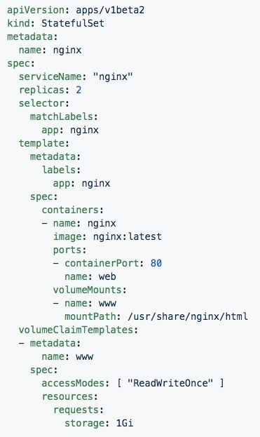
StatefulSet
Attaches to ‘headeless service’ (not shown) nginx.
Pods given unique ordinal names using the pattern
<statefulset name>-<ordinal index>.
Creates independent persistent volumes based on the ‘volumeClaimTemplates’.

Slide 28
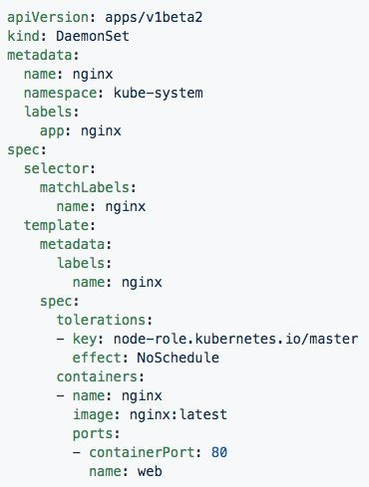
DaemonSet
Bypasses default scheduler
Schedules a single instance on every host while adhering to tolerances and taints.

Slide 29
Concepts - Workloads (cont.)
Job - The job controller ensures one or more pods are executed and successfully terminates. It will do this until it satisfies the completion and/or parallelism condition.
CronJob - An extension of the Job Controller, it provides a method of executing jobs on a cron-like schedule.

Slide 30
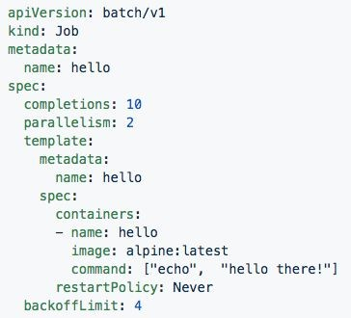
Jobs
Number of pod executions can be controlled via spec.completions
Jobs can be parallelized using spec.parallelism
Jobs and Pods are NOT automatically cleaned up after a job has completed.

Slide 31
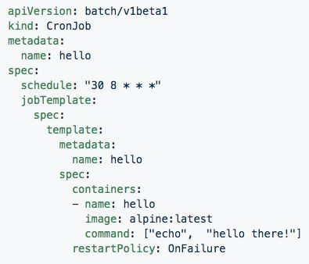
CronJob
Adds cron schedule to job template

Slide 32
Concepts - Network
Service - Services provide a method of exposing and consuming L4 Pod network accessible resources. They use label selectors to map groups of pods and ports to a cluster-unique virtual IP.
Ingress - An ingress controller is the primary method of exposing a cluster service (usually http) to the outside world. These are load balancers or routers that usually offer SSL termination, name-based virtual hosting etc.

Slide 33
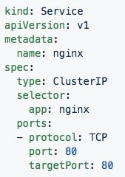
Service
Acts as the unified method of accessing replicated pods.
Four major Service Types:
CluterIP - Exposes service on a strictly cluster-internal IP (default)
NodePort - Service is exposed on each node’s IP on a statically defined port.
LoadBalancer - Works in combination with a cloud provider to expose a service outside the cluster on a static external IP.
ExternalName - used to references endpoints OUTSIDE the cluster by providing a static internally referenced DNS name.

Slide 34
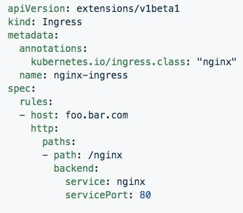
Ingress Controller
Deployed as a pod to one or more hosts
Ingress controllers are an external controller with multiple options.
Nginx
HAproxy
Contour
Traefik
Specific features and controller specific configuration is passed through annotations.

Slide 35
Concepts - Storage
Volume - Storage that is tied to the Pod Lifecycle, consumable by one or more containers within the pod.
PersistentVolume - A PersistentVolume (PV) represents a storage resource. PVs are commonly linked to a backing storage resource, NFS, GCEPersistentDisk, RBD etc. and are provisioned ahead of time. Their lifecycle is handled independently from a pod.
PersistentVolumeClaim - A PersistentVolumeClaim (PVC) is a request for storage that satisfies a set of requirements instead of mapping to a storage resource directly. Commonly used with dynamically provisioned storage.
StorageClass - Storage classes are an abstraction on top of an external storage resource. These will include a provisioner, provisioner configuration parameters as well as a PV reclaimPolicy.

Slide 36
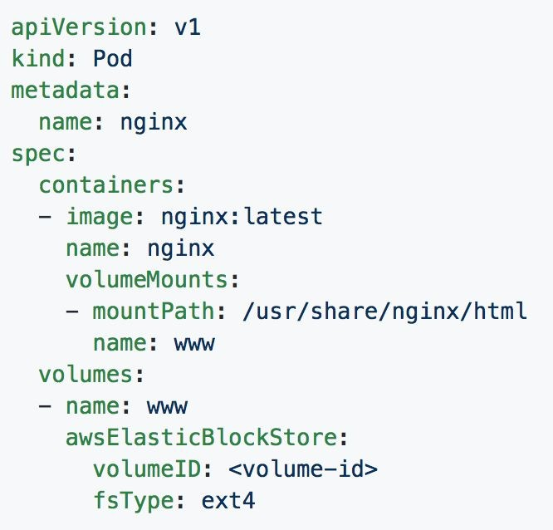
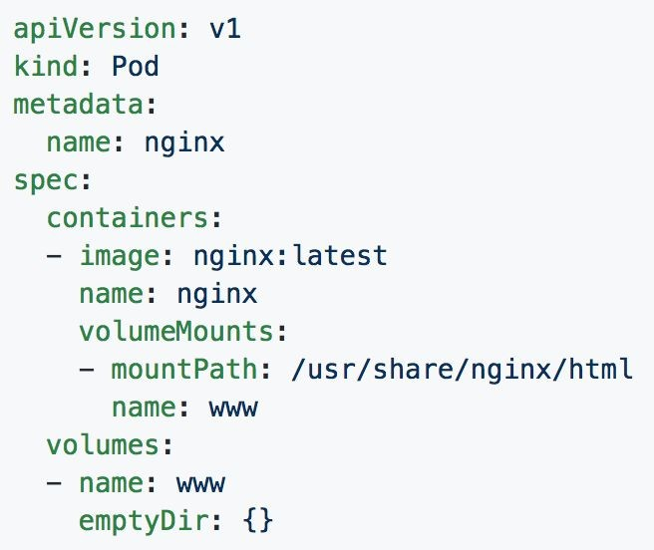
Volumes

Slide 37
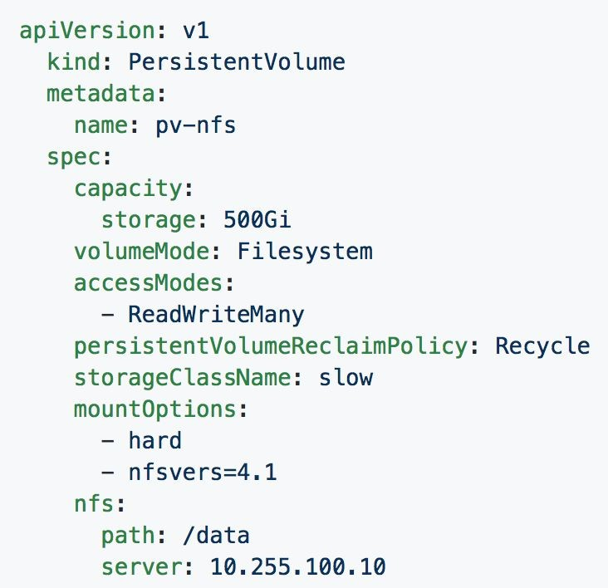
Persistent Volumes
PVs are a cluster-wide resource
Not directly consumable by a Pod
PV Parameters:
Capacity
accessModes
ReadOnlyMany (ROX)
ReadWriteOnce (RWO)
ReadWriteMany (RWX)
persistentVolumeReclaimPolicy
Retain
Recycle
Delete
StorageClass

Slide 38
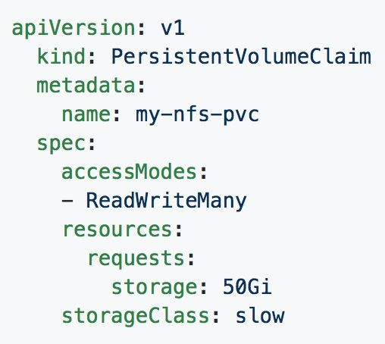
Persistent Volume Claims
PVCs are scoped to namespaces
Supports accessModes like PVs
Uses resource request model similar to Pods
Claims will consume storage from matching PVs or StorageClasses based on storageClass and selectors.

Slide 39
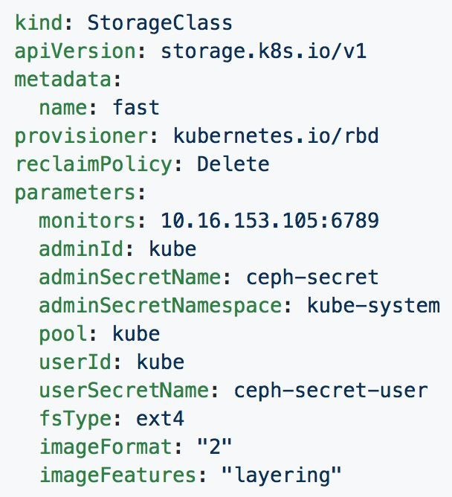
Storage Classes
Uses an external system defined by the provisioner to dynamically consume and allocate storage.
Storage Class Fields
Provisioner
Parameters
reclaimPolicy

Slide 40
Concepts - Configuration
ConfigMap - Externalized data stored within kubernetes that can be referenced as a commandline argument, environment variable, or injected as a file into a volume mount. Ideal for separating containerized application from configuration.
Secret - Functionally identical to ConfigMaps, but stored encoded as base64, and encrypted at rest (if configured).

Slide 41
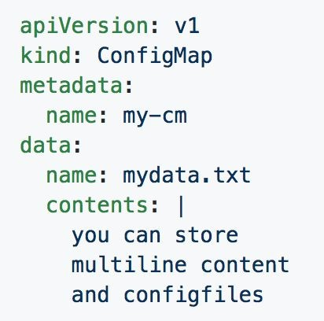
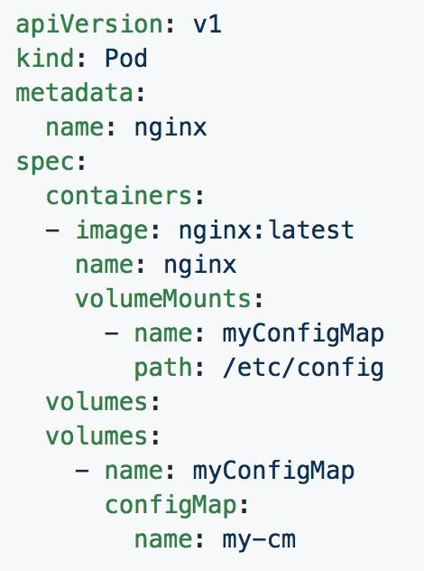
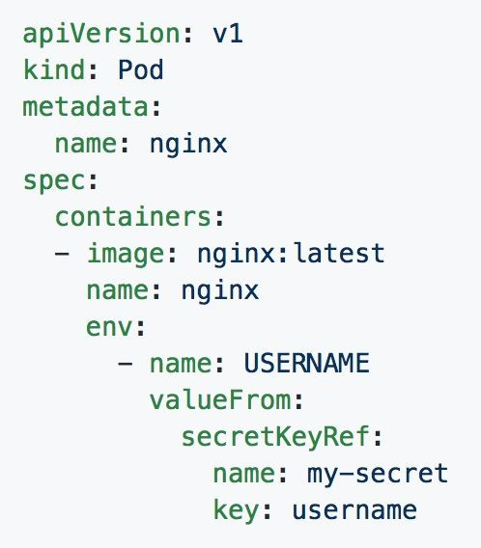
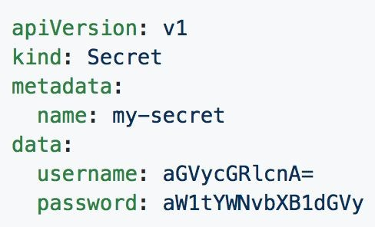
ConfigMaps and Secrets
Can be used in Pod Config:
Injected as a file
Passed as an environment variable
Used as a container command (requires passing as env var)

Slide 42
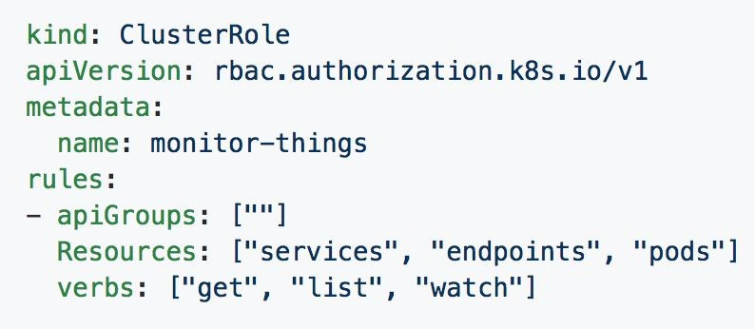
[Cluster]Role
Permissions translate to url path. With “” defaulting to core group.
Resources act as items the role should be granted access to.
Verbs are the actions the role can perform on the referenced resources.

Slide 43
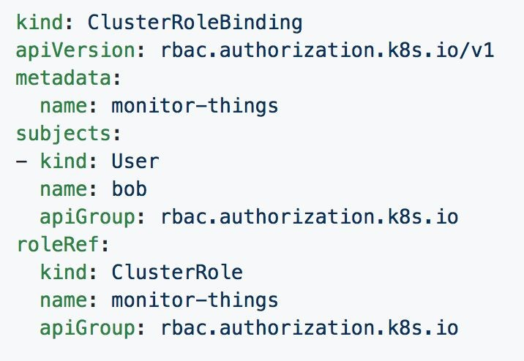
[Cluster]RoleBinding
Can reference multiple subjects
Subjects can be of kind:
User
Group
ServiceAccount
roleRef targets a single role only.

Slide 44
Further Reading
https://spacelift.io/blog/kubernetes-devops
https://www.aquasec.com/cloud-native-academy/kubernetes-101/kubernetes-devops/

Slide 45
ASSIGNMENT
Watch this video as discussed in class again → https://www.youtube.com/watch?v=r2zuL9MW6wc
Visit the below and ensure to follow along all 6 modules from this page. As a DevOps engineer reading documentation is important, these 6 small exercises will help you get up to speed → https://minikube.sigs.k8s.io/docs/tutorials/kubernetes_101/

